Slide 1
Job Recommender system
Presented by:
Gunjan Batra
Anita Chimnani
Sreevarsha Putcha

Slide 2
Problem Statement:
Predict the Job an “applicant” would apply to based on users past job applications and other user attributes
Users data
Jobs data
Users History
data
Application data
Windows data

Slide 3
Data Description
Data was obtained from Kaggle.com
Jobs
Users
Application
User ID
Window ID
City
State
Country
Zip code
Degree type
Major
Graduation Date
Work history
Total years of experience
Currently employed
Managed others
Job Title
Job ID
Title
Description
Requirement
City
State
Country
Zip code
User ID
Window ID
Application date
Job ID

Slide 4
Where did we start?
Explore the Data
Clean the Data
visualize the data

Slide 5
Steps in Data Cleaning:
Req_words
Explore the outliers
RegEx to remove bad data
Normalize the data
Select the data to work on
Remove the NAs and empty spaces
Visualize to see the difference

Slide 6
Data Reduction details
Total data
>dim(Usersdata) [1] 389708 ` 15
Jobs data
dim(jobs_data) [1] 1000 11
User’s data
dim(user_data_complete) [1] 300008 19
> dim(UsersHistory) [1] 907403 5
> dim(apps) [1] 1603111 5
> dim(jobs_data) [1] 56288 11
dim(user_data_clean) [1] 300008 19
> dim(JD_clean) [1] 993 11

Slide 7
Was that the end of it?
Of course not!
We deleted state values whose length is > 30 characters
We subset the data to create dummy variables
We formatted the date object to find patterns
We tried finding patterns in frequently occurring words

Slide 8
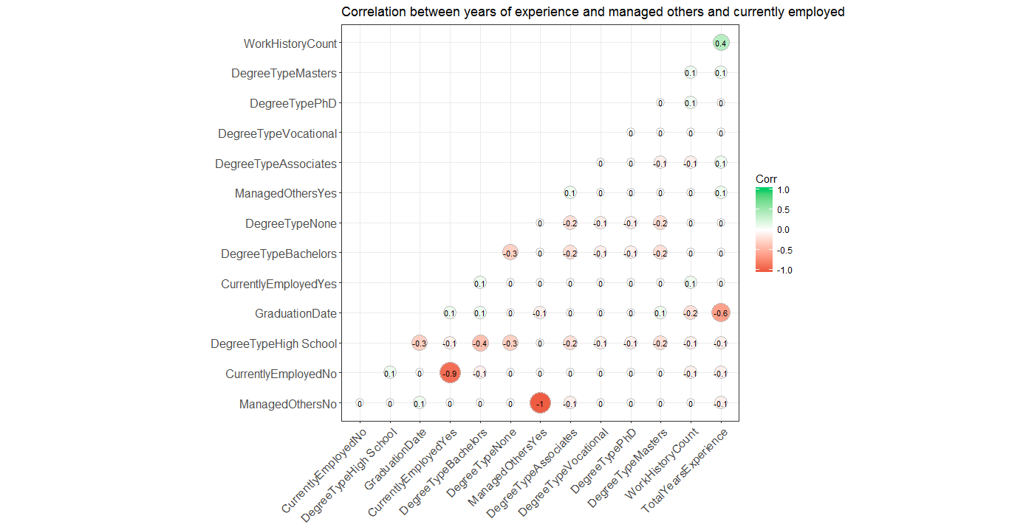
How related is the data?

Slide 9
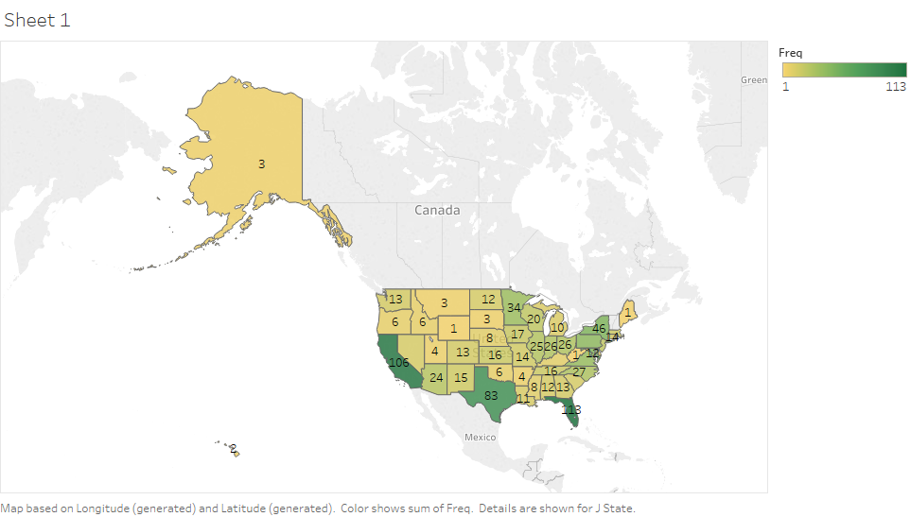
Counts of jobs offered - by state

Slide 10
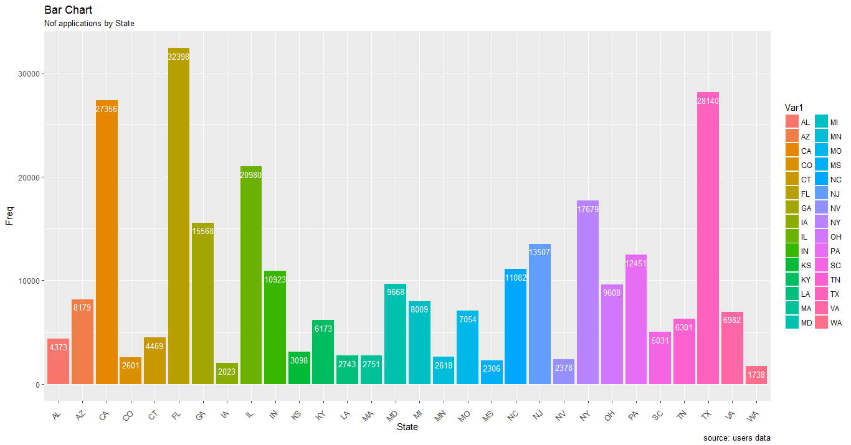
By state

Slide 11



So What did we realize:
Our data has a lot of values which are misplaced, irregular and unnecessary
Majority of our analysis so far does not directly contribute to end result
Because it is not a cook book!!!
It gave a holistic understanding of the data
Which now is clean!!!

Slide 12
System Description
Text Mining of Job description column
Jobs Clustering on basis of Job Description
Assign Candidates to Job Clusters based on Past Application History and got List of Jobs
For Every User in a Cluster - Compute Similarity of User Attribute to the corresponding Job attribute
Rank the Jobs by getting cumulative score

Slide 13
Text Mining Process
Job Clustering
Lowercase
Punctuation
Numbers
White Spaces
Stopwords
Document Term Matrix
LDA Clustering

Slide 14
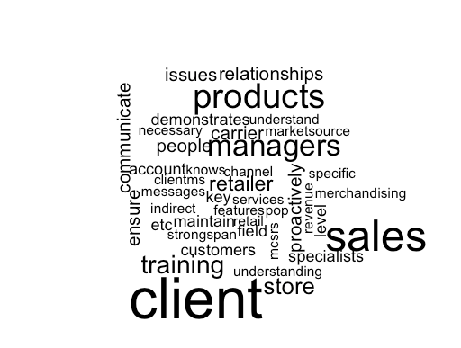
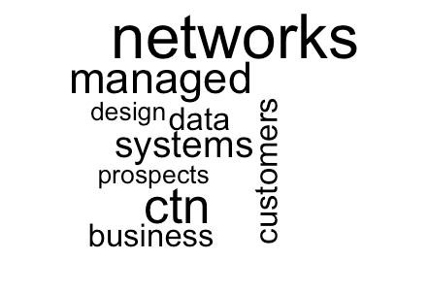

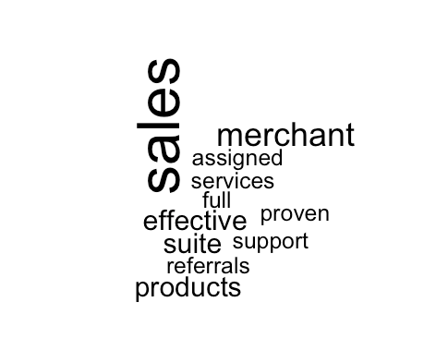
Finding Clusters: Inspect DTM
Finding key words from job titles, requirements, descriptions, applicant’s majors:
Basic exploration
Clean the titles
Split the titles into single words
Find the unique words
Make a table of word count and unique words
Apply word cloud function

Slide 15
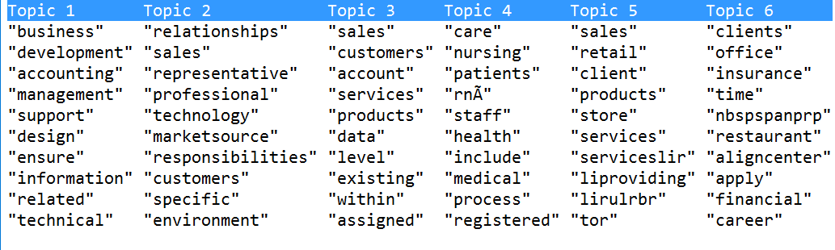
Job Clusters
Job Clustering

Slide 16
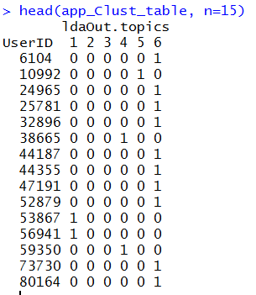
Relation - Assign Candidates to Job Clusters
Job Clustering
User Cluster matrix
{1:n}<- If User Belongs to the Cluster
0<- If User Belongs to the Cluster

Slide 17
Results
Removed 105 Stopwords
We converted 151 Documents Predicted jobs to 6 Topics
 | Cluster 1 | Cluster 2 | Cluster 3 | Cluster 4 | Cluster 5 | Cluster6 | Total
Jobs | 33 | 25 | 16 | 26 | 17 | 34 | 151
Users | 46 | 25 | 11 | 5 | 5 | 152 | 244

Slide 18
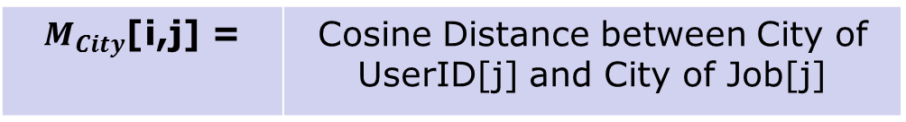
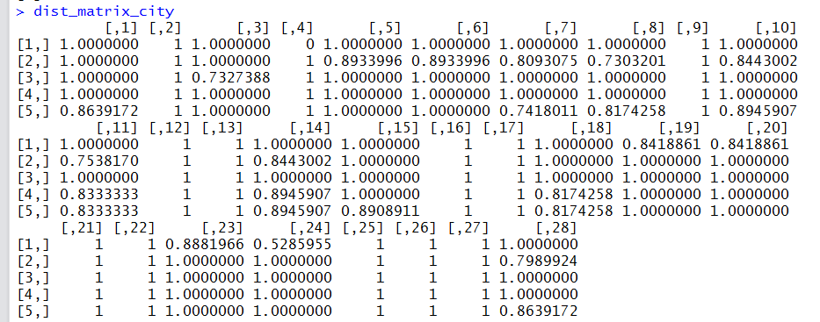

Similarity between User Location and Job Opening Location
Job Ranking
$${Similarity Matrix}_{City} ,M_{City}$$
Matrix of Cosine Similarity measures between City of User and City of Job Opening

Slide 19
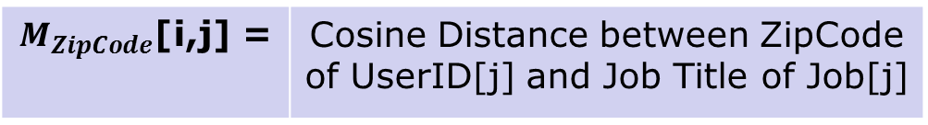
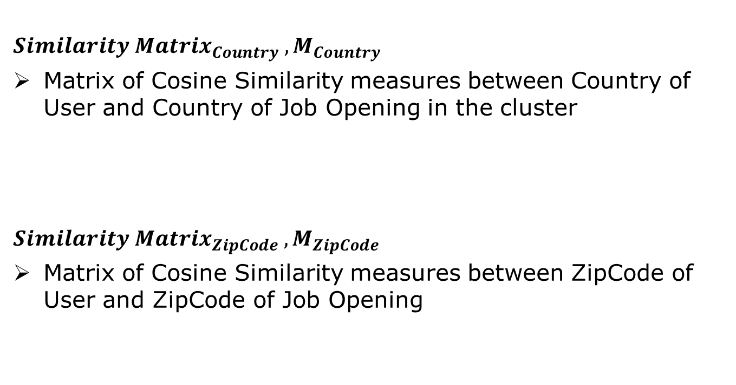
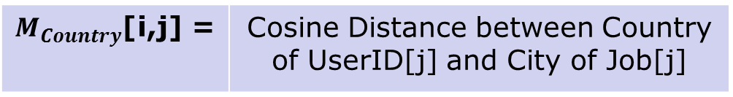
Similarity between User Location and Job Opening Location
Job Ranking
$${Similarity Matrix}_{Country} ,M_{Country}$$
Matrix of Cosine Similarity measures between Country of User and Country of Job Opening in the cluster
$${Similarity Matrix}_{ZipCode} ,M_{ZipCode}$$
Matrix of Cosine Similarity measures between ZipCode of User and ZipCode of Job Opening
$M_{Country}$[i,j] = | Cosine Distance between Country of UserID[j] and City of Job[j]
 | Cosine Distance between ZipCode of UserID[j] and Job Title of JobID[j]

Slide 20

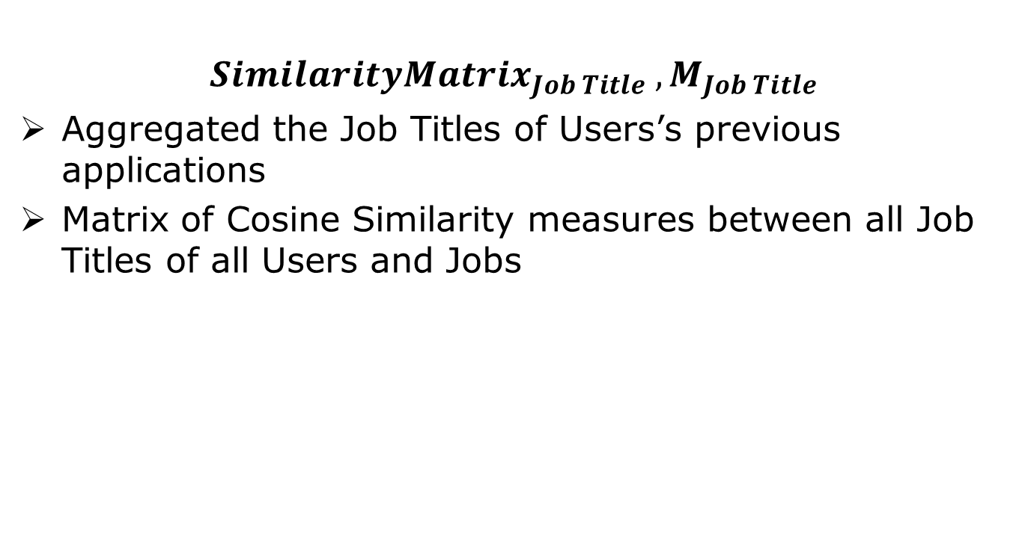
Similarity between Job Titles of User Applications and Job Title of Job Openings
Job Ranking
$${SimilarityMatrix}_{Job Title} ,M_{Job Title}$$
Aggregated the Job Titles of Users’s previous applications
Matrix of Cosine Similarity measures between all Job Titles of all Users and Jobs
 | Cosine Similarity between Job Title of UserID[j] and Job Title of JobID[j]

Slide 21
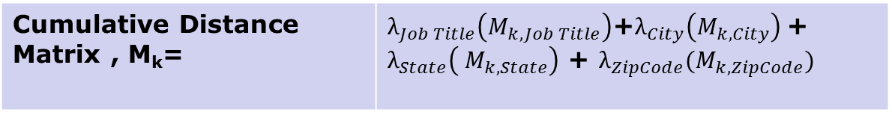
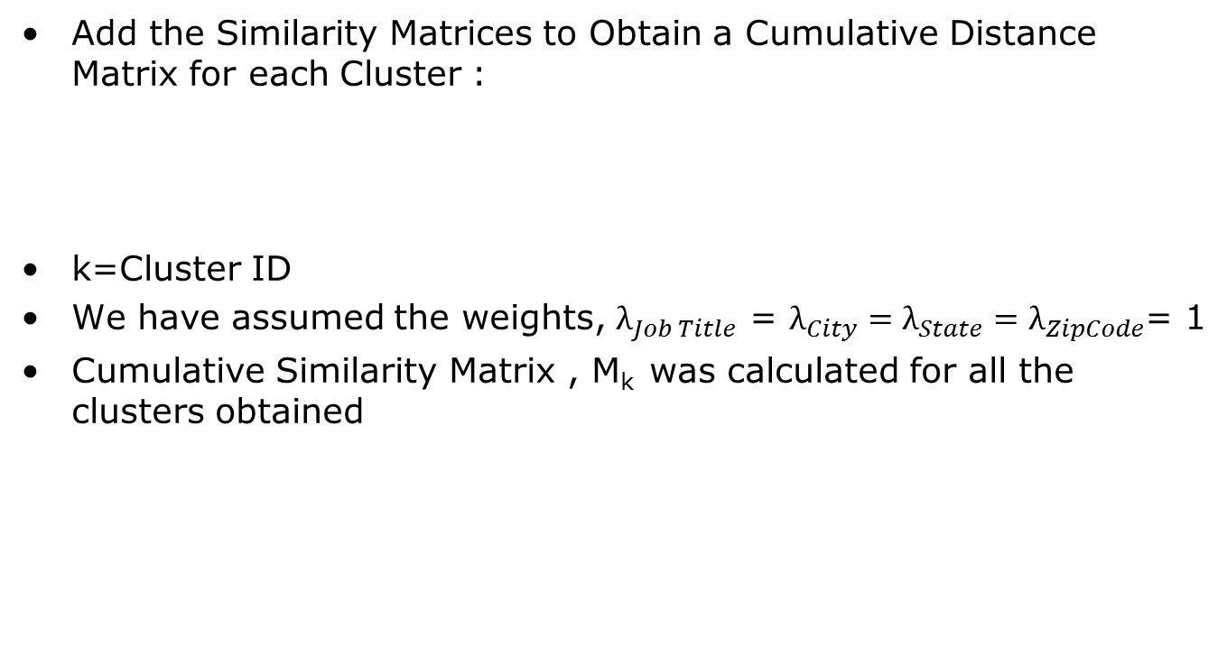
Final Similarity Measure
Job Ranking
Add the Similarity Matrices to Obtain a Cumulative Distance Matrix for each Cluster :
k=Cluster ID
We have assumed the weights, $λ_{Job Title}$ = $λ_{City}=λ_{State}=λ_{ZipCode}$= 1
Cumulative Similarity Matrix , M_{k} was calculated for all the clusters obtained
Cumulative Distance Matrix , M_{k}= | $λ_{Job Title}\left(M_{k,Job Title}\right)$+$λ_{City}\left(M_{k, City}\right)$+ $λ_{State}\left({ M}_{k,State}\right)$ + $λ_{ZipCode}(M_{k,ZipCode})$

Slide 22
Job Ranking
Job Ranking
Largest 5 Distances were selected for every UserID
Corresponding jobs were ranked as Top 5 Recommended Jobs for every User in a cluster

Slide 23
Conclusion and Future Work
Obtained meaningful clusters from Jobs Data
Obtained User Job Prediction based on Clusters they belonged to
Ranked Top-5 Jobs for every User based on Cosine Similarity Measure
Include the Case when Candidate is assigned to more than one cluster
Try collaborative filtering, for Item-Item and User-Item.

Slide 24
Thank You
Questions???

Slide 25
Appendix

Slide 26
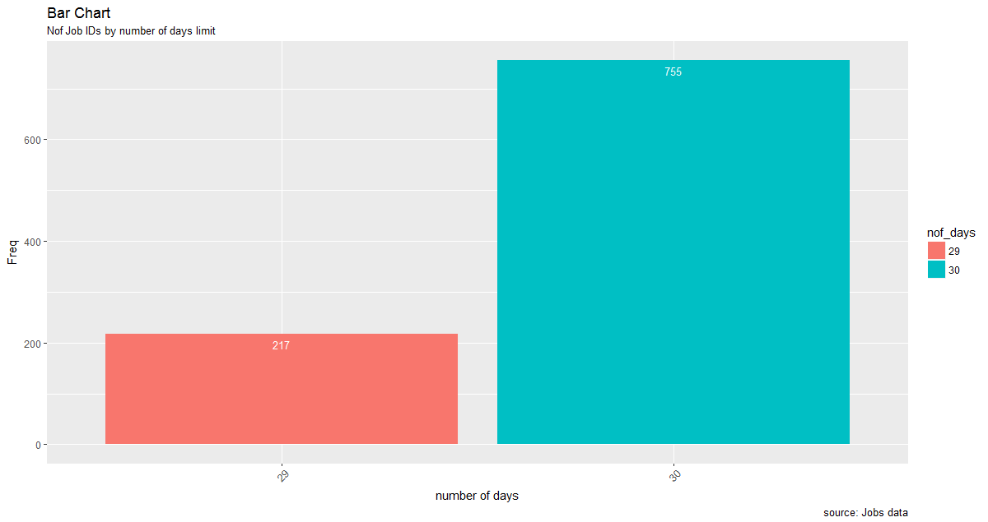
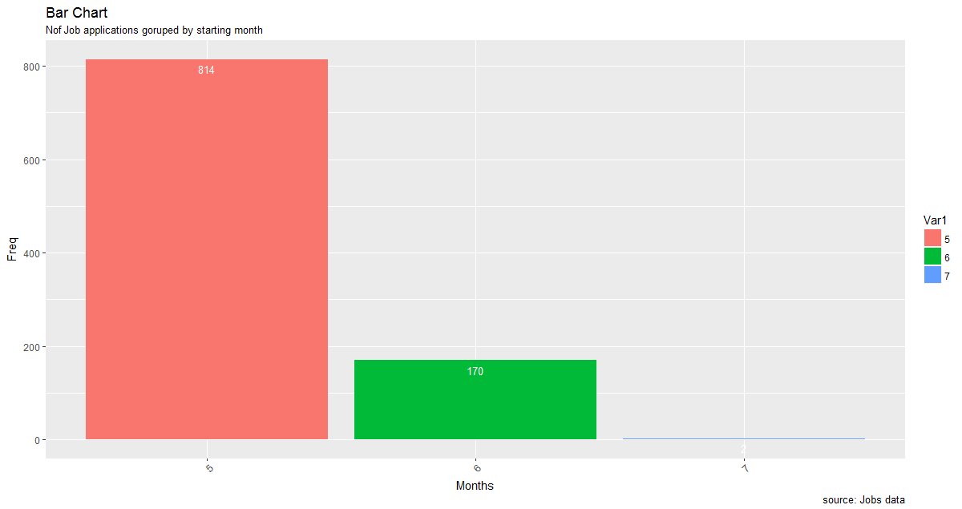
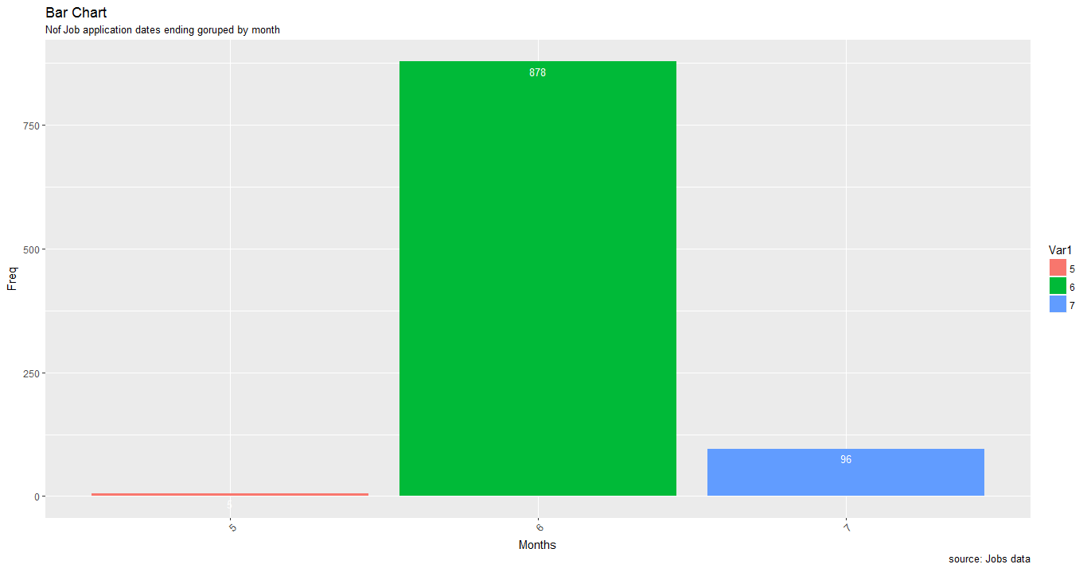
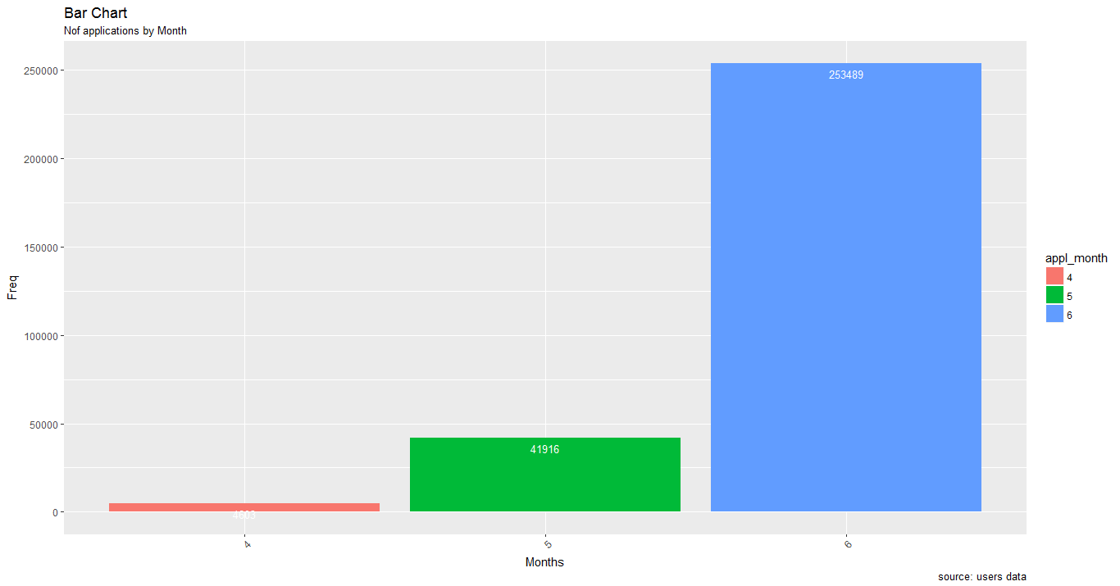
Summary of jobs posted and applied for Dates

Slide 27
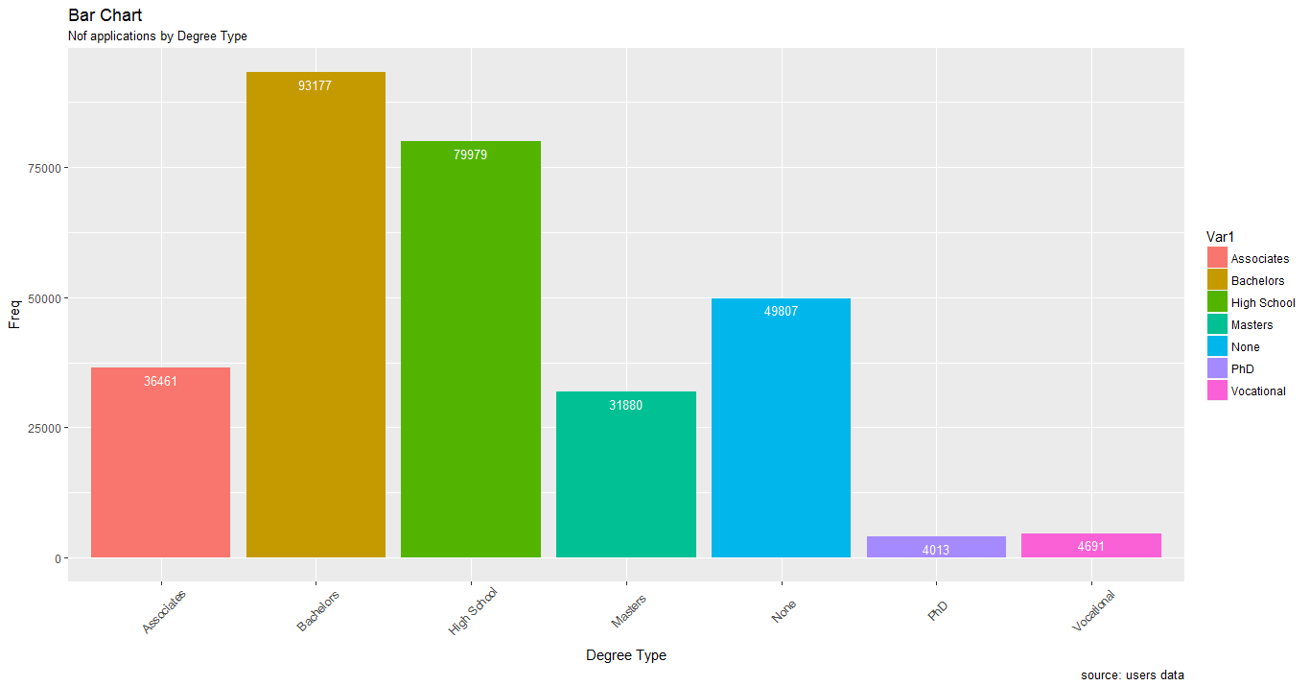
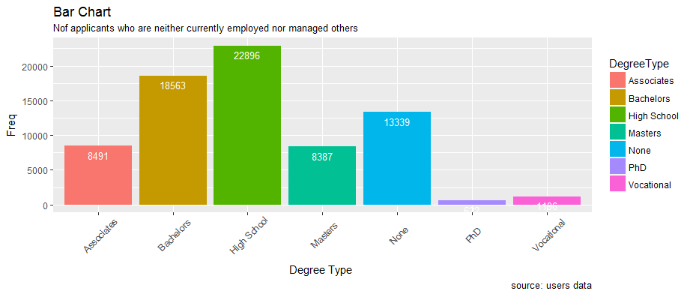
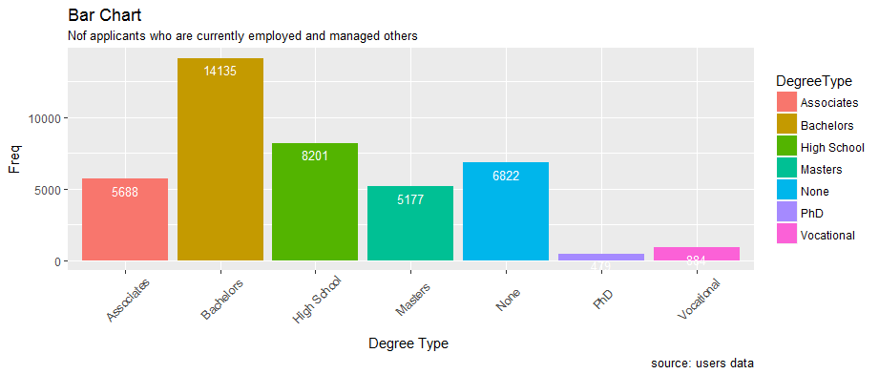
Degree type

Slide 28
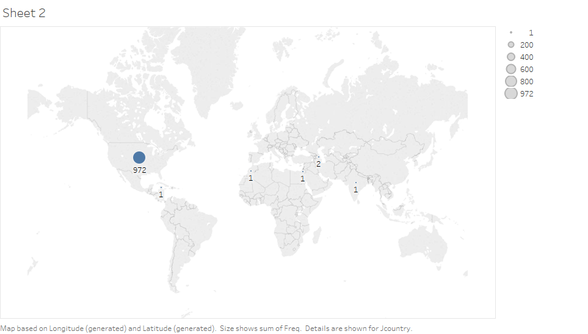
Offered - By country

Slide 29
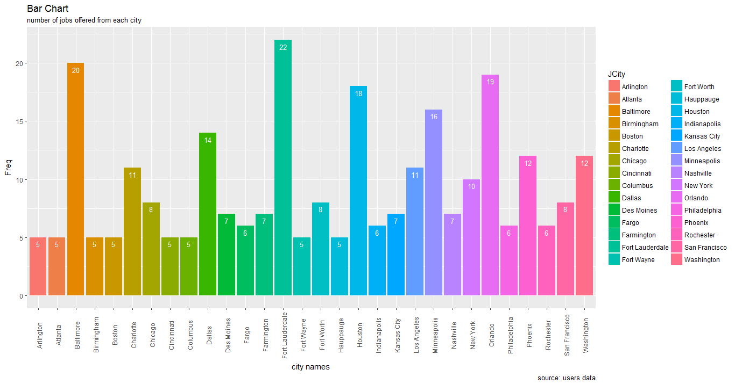
Jobs Offered - by City

Slide 30
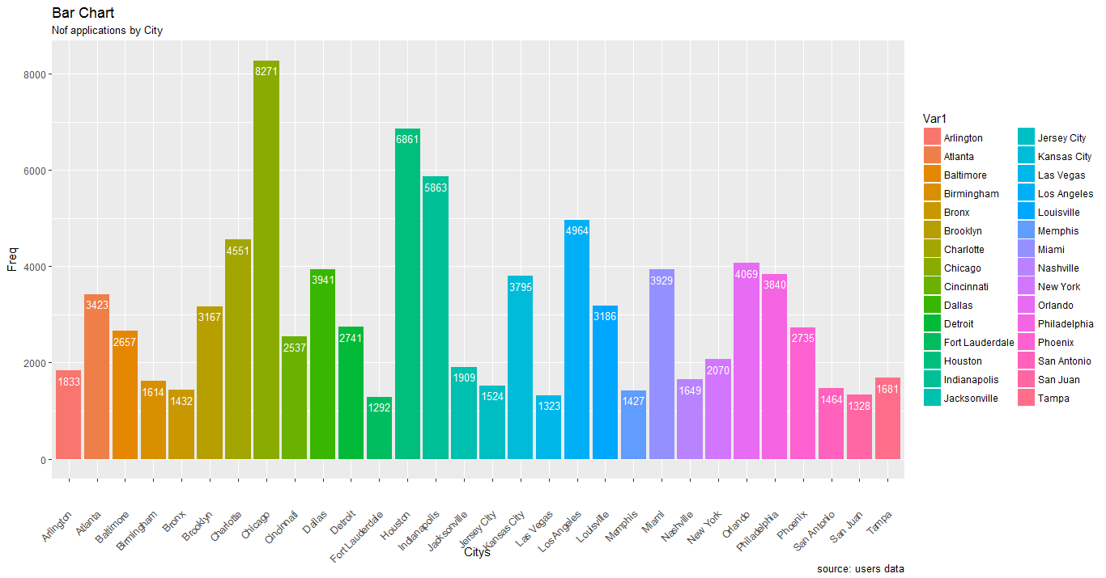
Jobs Applied for – by City

Slide 31
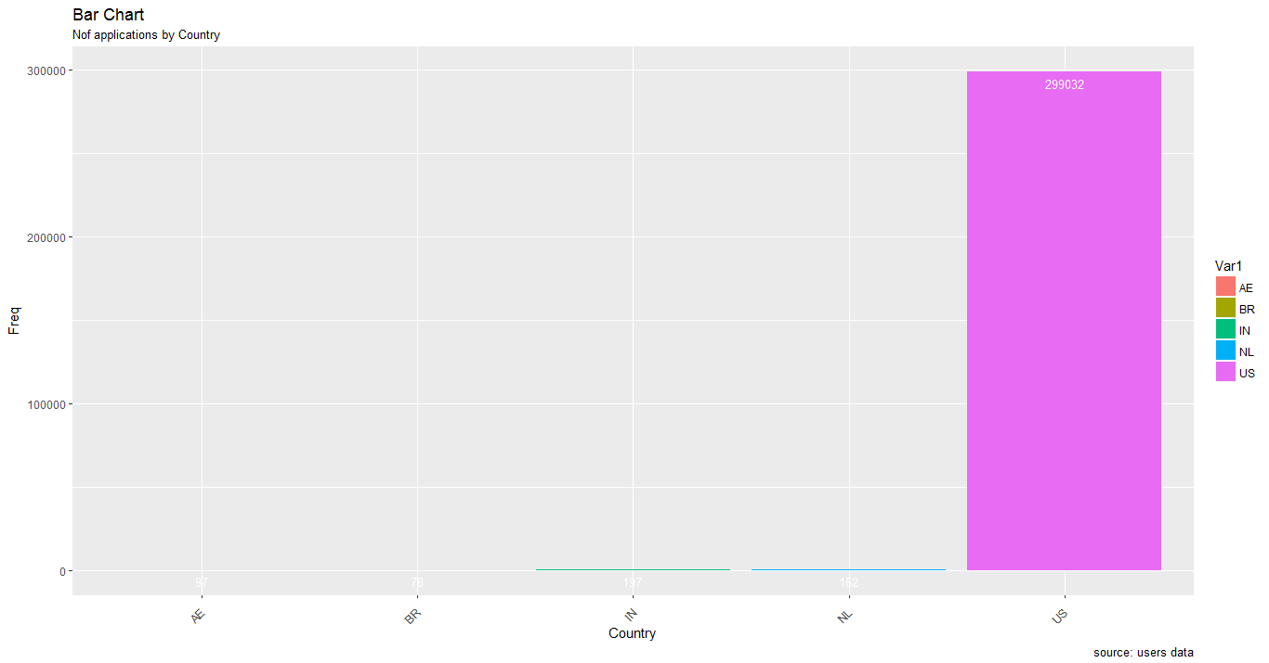
-By Country

Slide 32
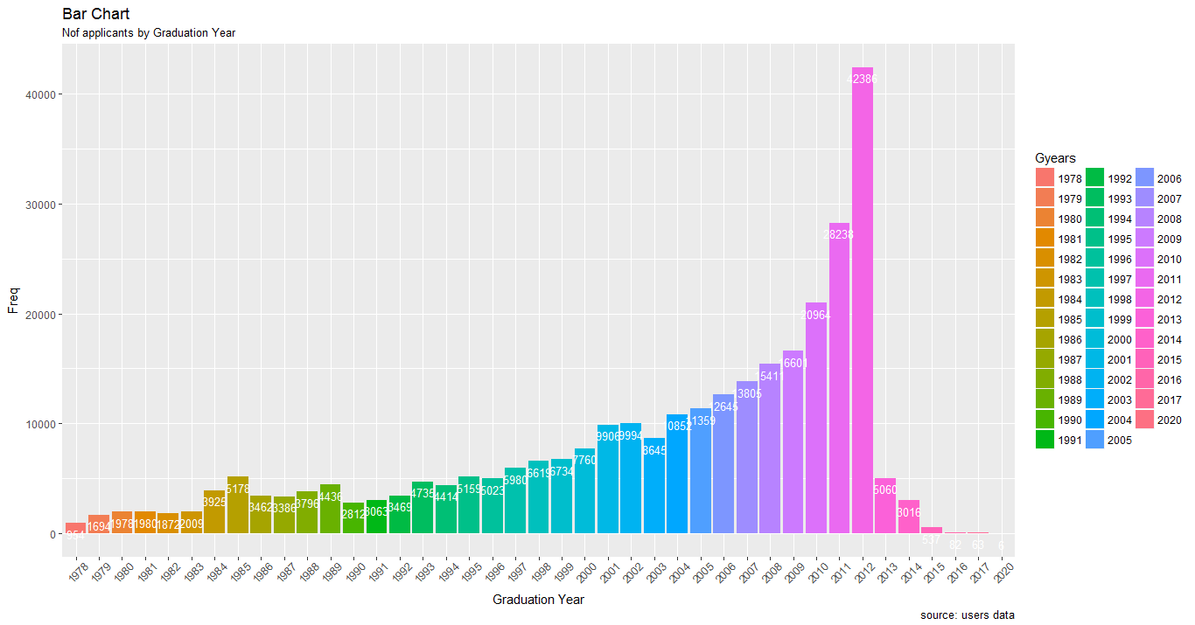
Summary of count of users:
Number of applicants by graduation year

Slide 33
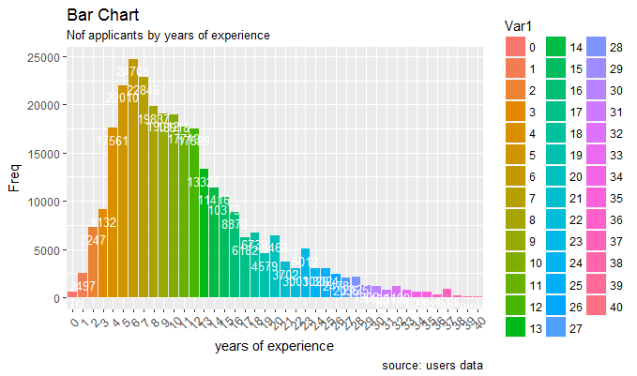
Years of experience

Slide 34
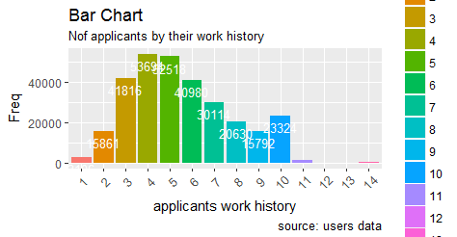
Work history

Slide 35
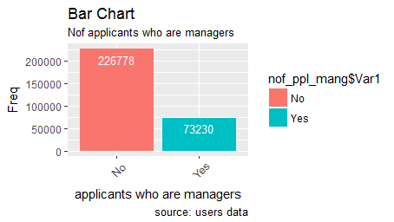
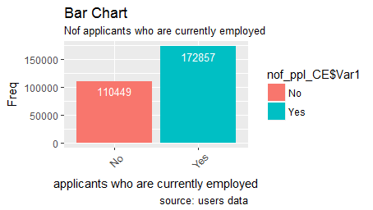
Number of - currently employed, managed others:

Slide 36
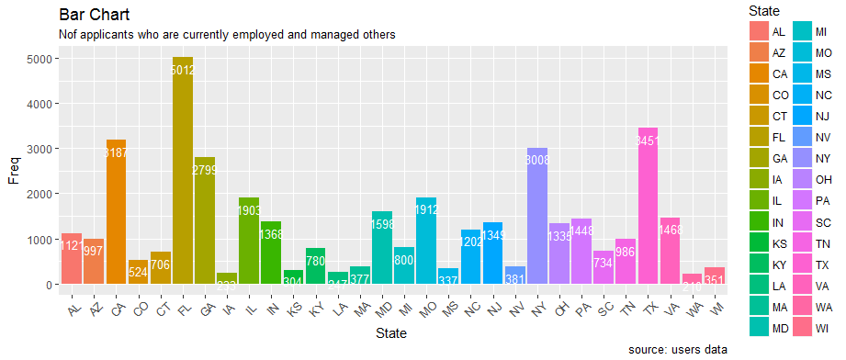
Currently employed and managed others by state

Slide 37
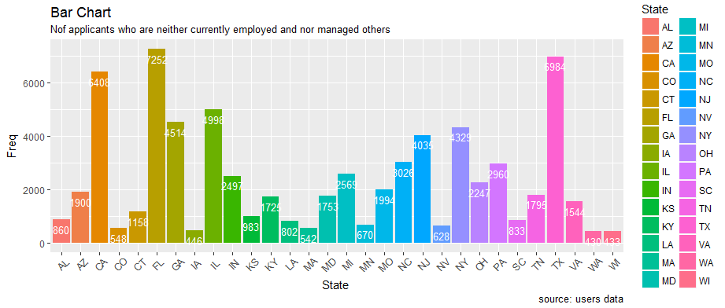
Neither Currently employed nor managed others by state

